Slide 1
Beck Row Attendance –11th – 15th March 2024

Slide 2
Beck Row Attendance –11th – 15th March 2024
10 - Rowling – 83%
=6 – Rosen – 91%
=6 – Cowell – 91%
=6 – Dahl – 91%
=6 – Morpurgo – 91%
=4 – Donaldson – 93%
=4 – Jeffers – 93%

Slide 3
In joint 2nd place…
Zephaniah and Blake – 94%

Slide 4
This weeks winners…
POTTER CLASS – 96%!

Slide 5
Changes to lunches and an exciting trip announcement.

Slide 6
Lunches – from today
From today, we will re-introduce bands for lunches
You will make your usual lunch choices in the morning
At lunch, you will then be lined up based on your choices.
When arriving at the hall, your teacher will direct you to sit if you have a packed lunch, or go to the cold queue if you are having cold.
Then your teacher will give you your bands for the hot queue –
Red = Hot main
Green = Hot main vegetarian
Yellow = Jacket Potato
You will then exchange your band with the kitchen staff for your meal.

Slide 7
Lunches – important rules
Do not swap your band with anyone
Keep it safe and hand it in to the lunch staff – if you do not have it, you will not get your lunch until it has been worked out what you were meant to have.
Continue with the excellent eating – this weeks main focus is staying in your seat!

Slide 8
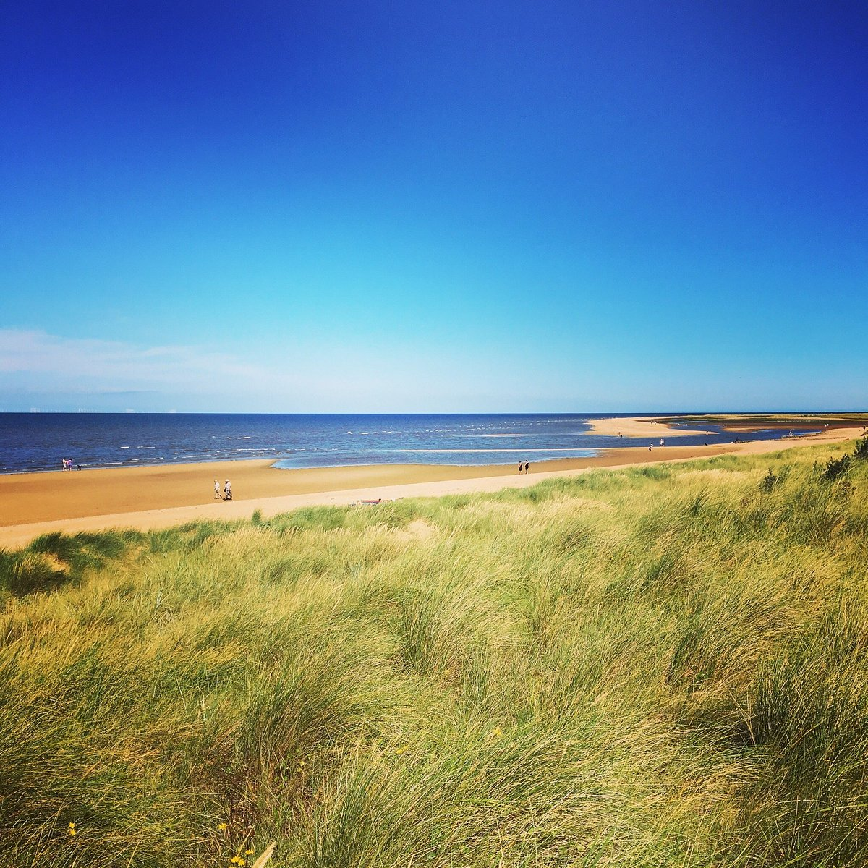
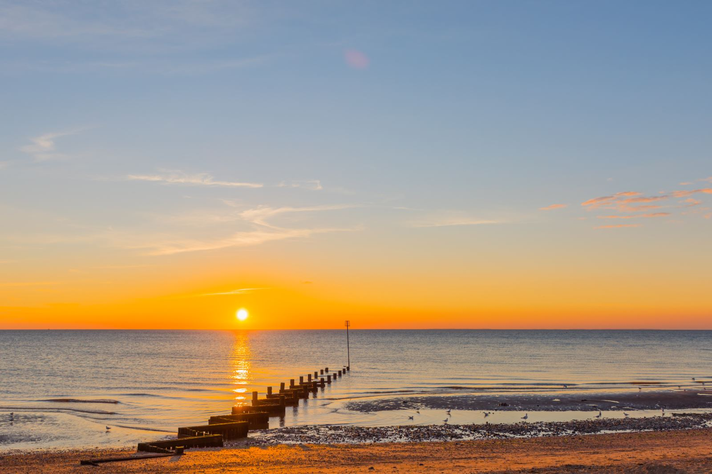
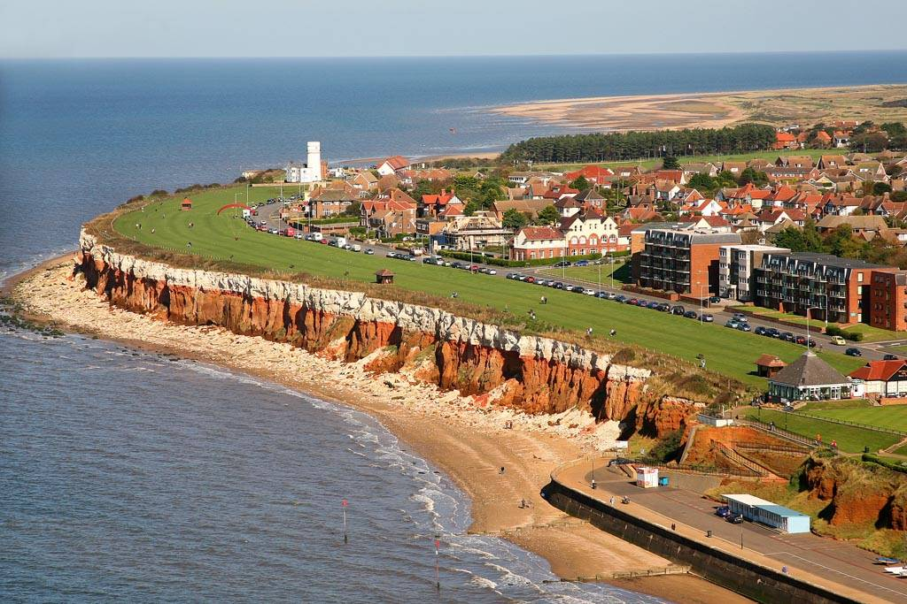
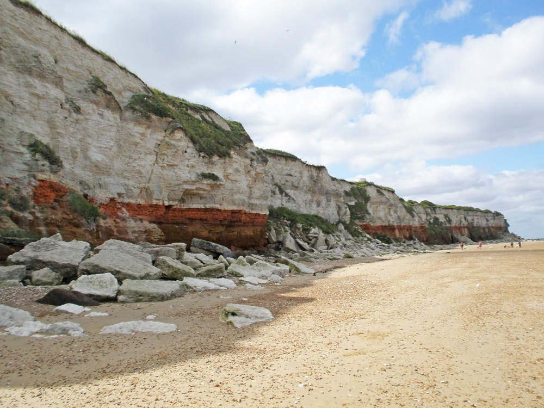
An exciting announcement…

Slide 9
In June or July we will be going on a WHOLE SCHOOL TRIP
We will ALL be going to Hunstanton for the day.
This trip will be FREE to all pupils too.
In order to make this happen, we will be doing lots of fundraising ideas over the next couple of months.
Now it is over to you and your teachers to come up with ideas.
The more money your class raise, the more they get to do.
Each class must raise £200 in order for the trip to happen.
Any more than this – the more fun things your day has!

