Slide 1
Beck Row Attendance – 29th January – 2nd February 2024
10 – Rosen – 76%
=8 – Rowling – 89%
=8 – Donaldson - 89%
7 – Zephaniah – 90%
6 – Jeffers – 91%
=3 – Dahl – 94%
=3 – Cowell – 94%
=3 – Morpurgo – 94%
2 – Blake – 97%

Slide 2
New winners this week….
Potter Class – 98%

Slide 3
OPAL
Kindness
Safety
Sharing
Responsibility

Slide 4
OPAL
Kindness
Safety
Sharing
Responsibility
WELLIES NEEDED
WASH HANDS AFTERWARDS

Slide 5
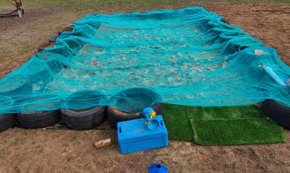
OPAL
Kindness
Safety
Sharing
Responsibility
When sheet is on- sandpit is closed
If the sandpit is full, go play elsewhere
NO MUD in the sand pit. Only sand toys used in pit.

Slide 6
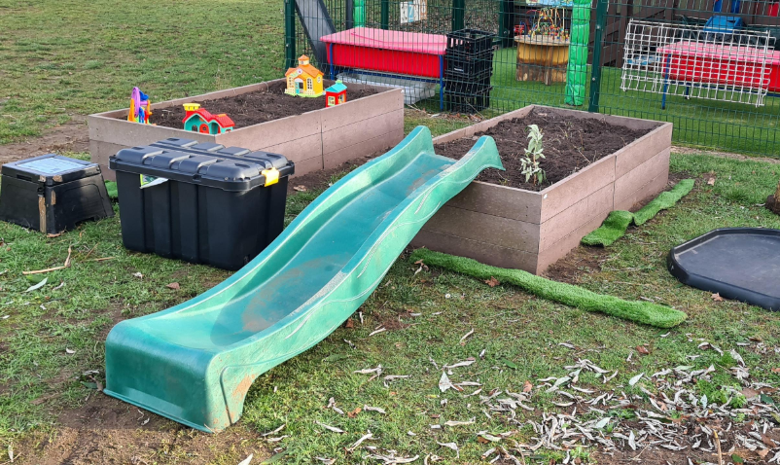
OPAL
Kindness
Safety
Sharing
Responsibility
Toys BACK in box after use
Play carefully with toys and sharing
Toys CANNOT leave zone

Slide 7
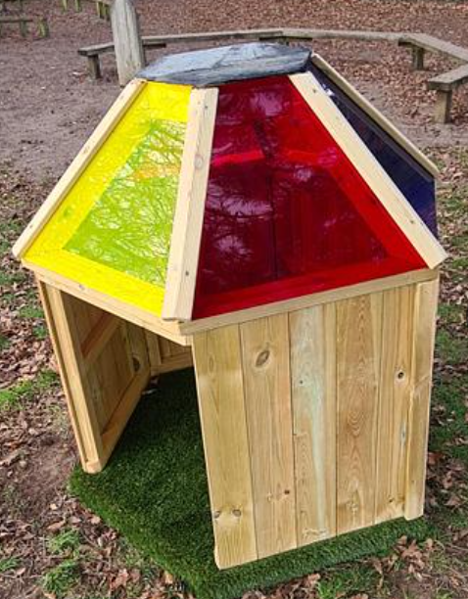
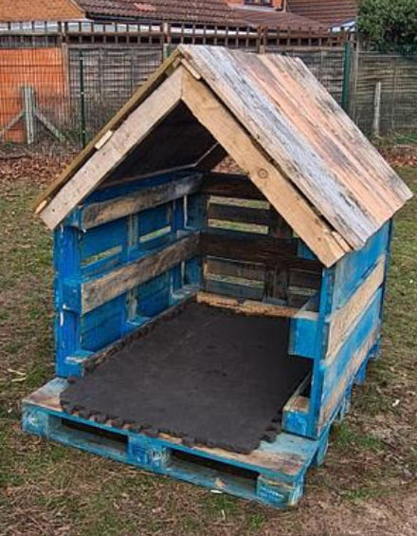
OPAL
Kindness
Safety
Sharing
Responsibility
No “ownership”

Slide 8
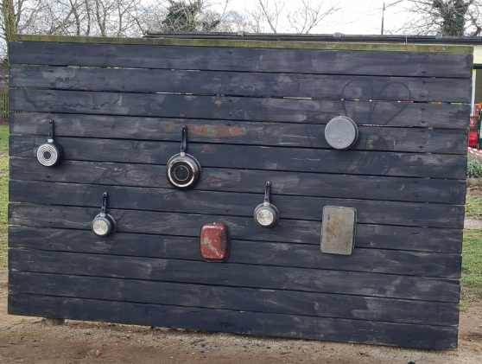
OPAL
Kindness
Safety
Sharing
Responsibility
Return beaters & drumsticks to the drawers

Slide 9
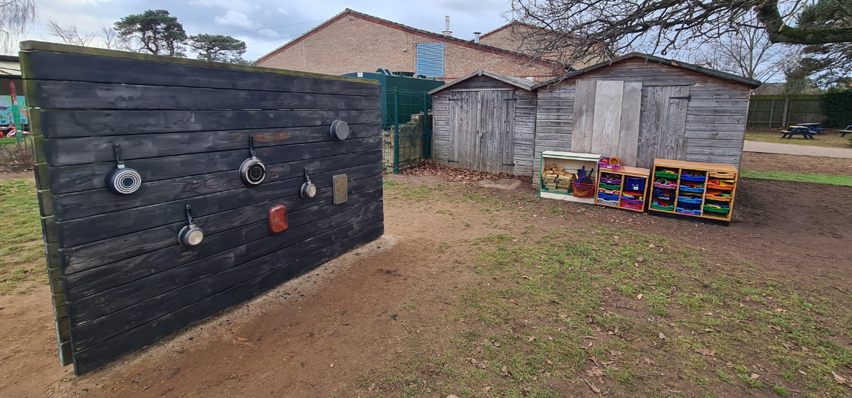
OPAL
Kindness
Safety
Sharing
Responsibility
All equipment MUST return to the drawers. Even if you did not use it, show kindness☺

Slide 10
OPAL
Kindness
Safety
Sharing
Responsibility
Scooters stored here. Children MUST remain in zone. Must tidy away at end of lunch.

