Slide 1
Beck Row Attendance – 22nd – 26th January 2024
Monday 29th January 2024

Slide 2
Beck Row Attendance – 22nd – 26th January 2024uary 2024
10 – Donaldson – 87%
9 – Rowling – 89%
=6 – Dahl - 90%
=6 – Cowell – 90%
=6 – Morpurgo – 90%
5 – Rosen – 93%
4 – Jeffers – 94%
=2 – Zephaniah – 95%
=2 – Potter – 95%

Slide 3
And they are back…
Blake Class – 97%
#bemoreblake

Slide 5
Leaving classrooms
It is not acceptable to leave a classroom without adult permission.
Leaving a classroom without asking a teacher will now result in losing 5 Dojos and will be classed as a T3.
It is not safe to be around the school on your own.
If you are now out in the corridors on your own, you will need a pass from your teacher.
Remaining in the class will result in positive staying safe Dojos!

Slide 6
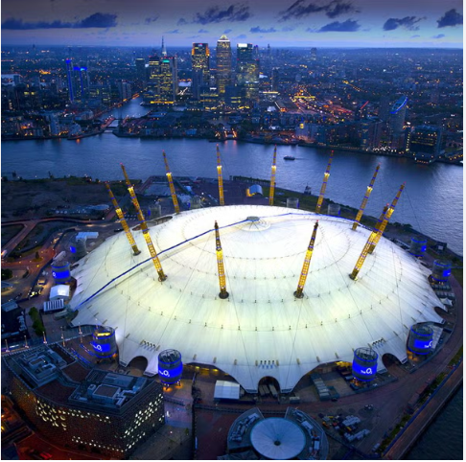
Young voices – today!!!!
Please wish the 24 pupils well today, as they travel to the o2 arena to represent Beck Row Primary Academy. We will be leaving at 10.30am and returning around midnight!

