Slide 1
Beck Row Attendance – 27th November – 1st December 2023

Slide 2
Attendance – 20th – 24th November 2023
10 – Rosen – 81%
9 – Rowling – 85%
=7 – Morpurgo - 88%
=7 – Potter – 88%
=5 – Jeffers – 90%
=5 – Dahl – 90%
=3 – Donaldson – 96%
=3 – Zephaniah – 96%

Slide 3
In Joint 3rd place…
Cowell - 97%

Slide 4
This weeks winners are….
Blake – 98%

Slide 5
Dojo/Golden Ticket/Awards
Amazing well done to all those who are starting to achieve their golden tickets!
We now have some pupils with 2!
Keep working hard everyone.
New update on amounts for Bronze, Silver, Gold and Platinum awards.
Bronze – 500 Dojos
Silver – 1000 Dojos
Gold – 1500 Dojos
Platinum – 2000 Dojos

Slide 6
From January 2024…
100% attendance each week = 1 raffle ticket
End of each term, all raffle tickets are put together and randomly drawn out.
There will be 5 winners each term of a £10 gift voucher.
This is a random draw, so anyone with a ticket can win. But the more 100% weeks, the more chances!

Slide 7
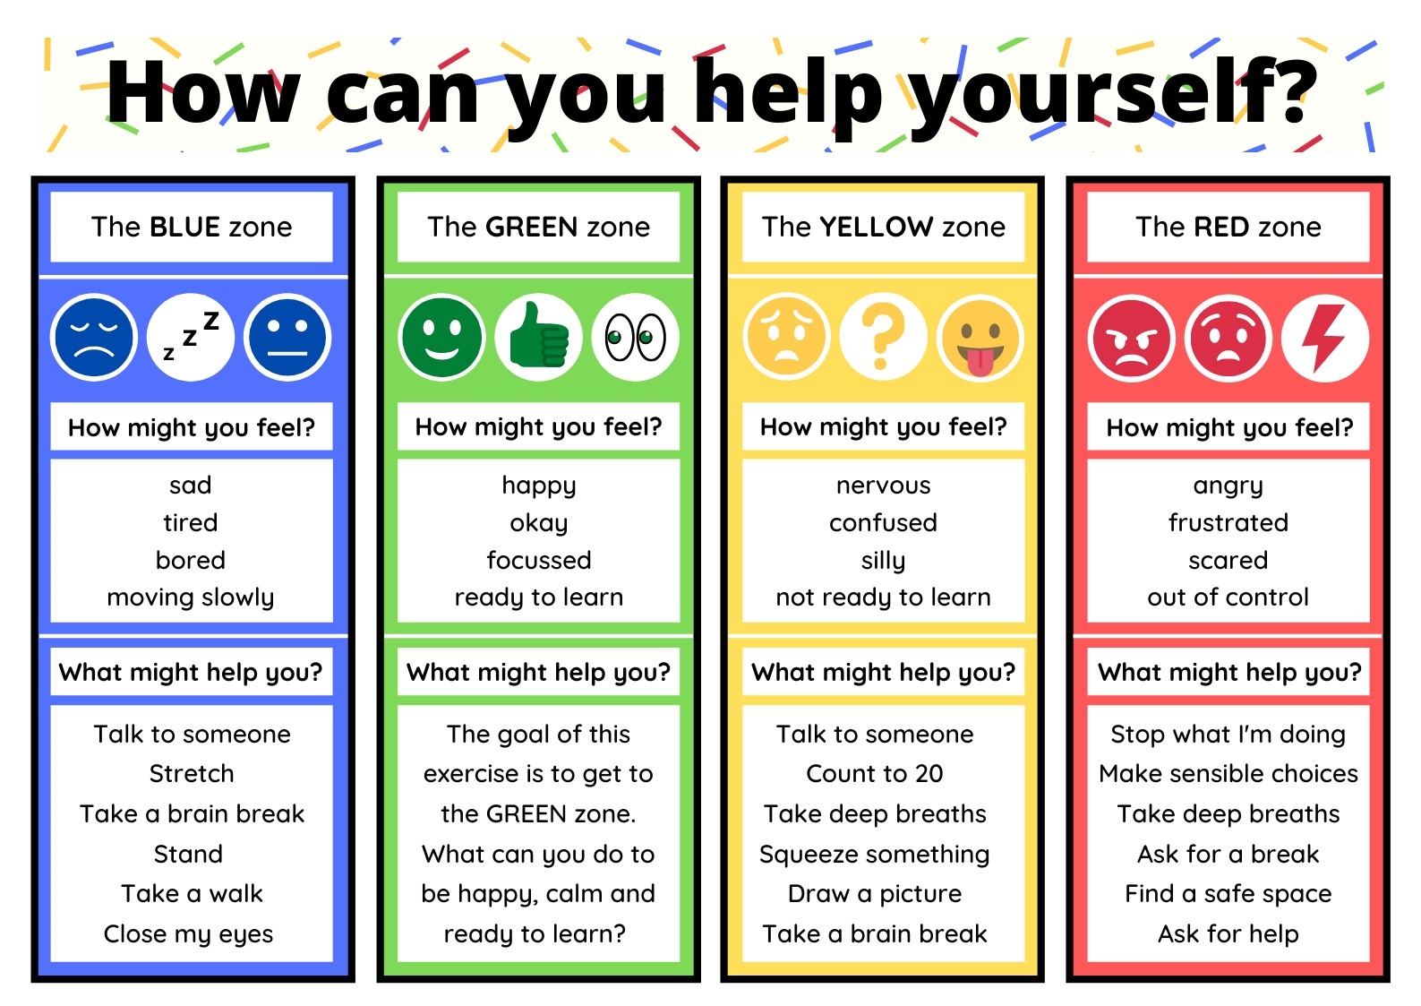

Slide 8
On Wednesday
On Wednesday we will be doing an assembly in line with National Grief Week.

